Slide 1

LLM Legal complaint analyzer
Liz Meyer
COSC 5931

Slide 2
problem
Legal professionals spend significant time on early-stage case assessment
Reviewing complaints
Identifying key legal issues
Formulating initial discovery questions
Legal complaints are long, dense, and time-sensitive, and can require up to 3-6 hours of review per case
This creates a bottleneck in case assessment and can delay the development of an initial legal strategy

Slide 3
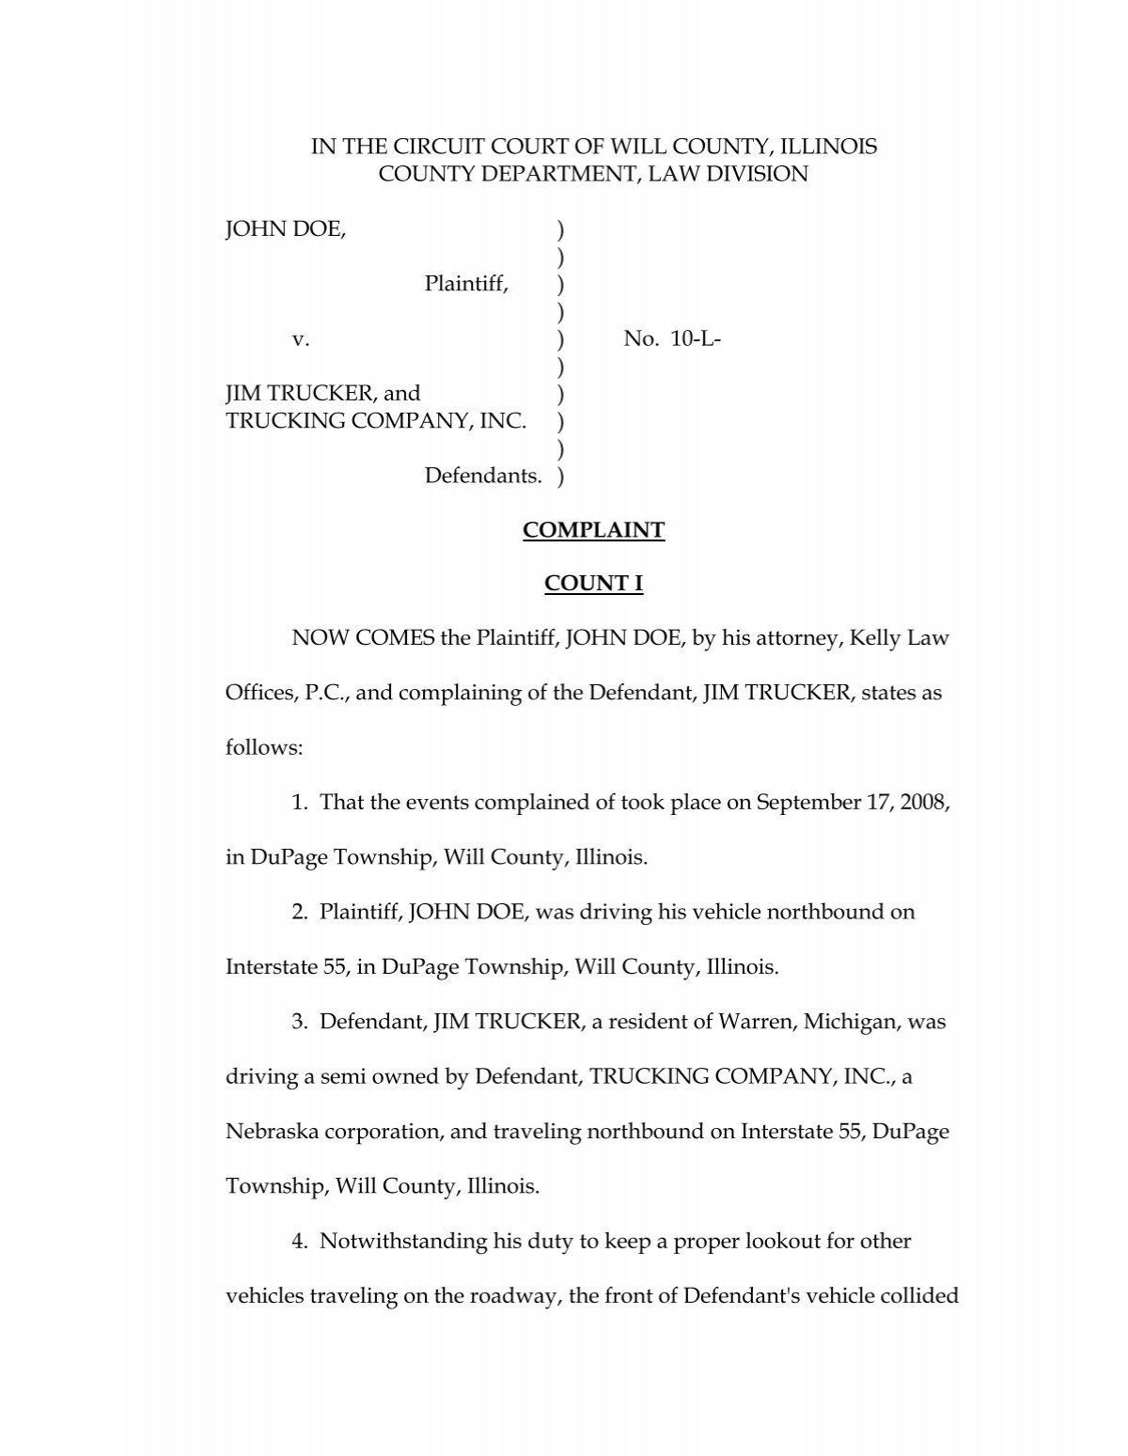
Goal
Project Goal: Build an LLM-powered tool that lets a user:
Upload a legal document → Receive a structured case summary + actionable attorney next steps
Intended as a case triage assistant, not as a replacement for legal judgement

Slide 4
architecture
React Front End
User uploads .pdf, .docx, or .txt file
Document Processing
Extracts plain text from the uploaded document
Summary + follow-up guidance displayed in app
Model: LLaMA 3.1 8B via Hugging Face API
Prompt 1 generates structured case summary
Prompt 2 generates attorney next steps
Python / FastAPI Back End
Receives file and coordinates analysis

Slide 5
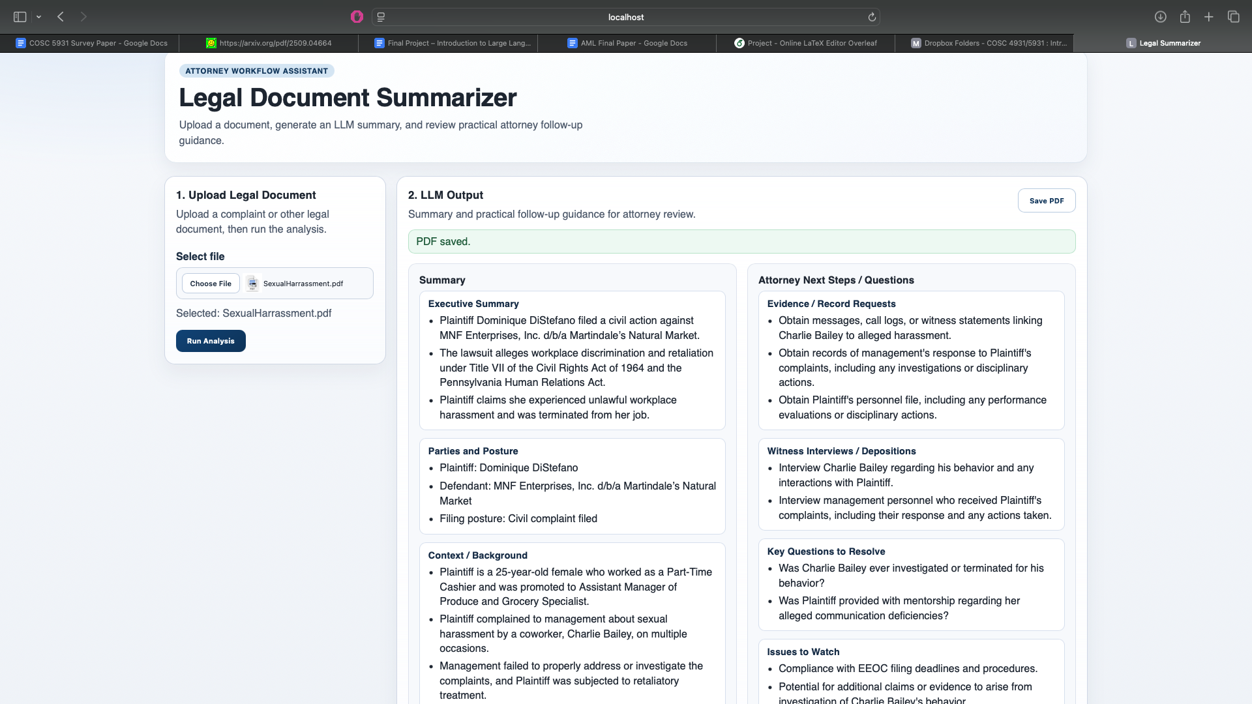
Lessons learned

Slide 6
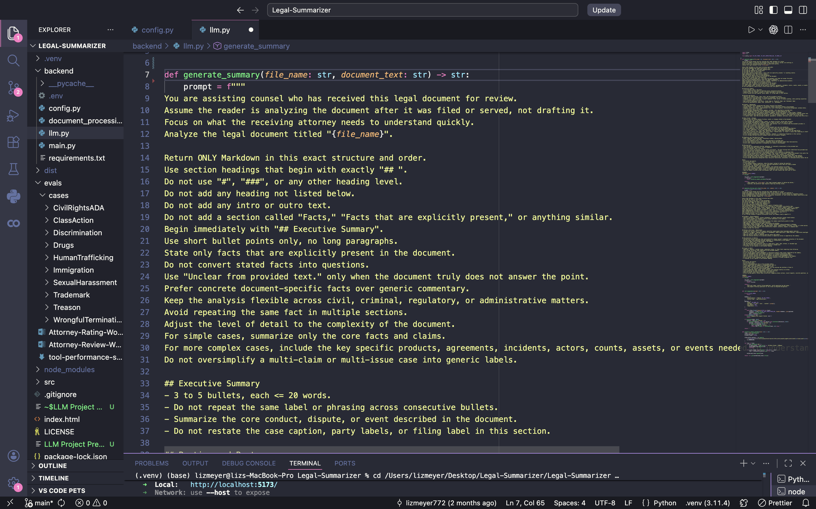
Prompt engineering
Significant part of project development + very iterative process
Used human attorney to collaborate with and design the prompts
Used primarily zero-shot prompting
Model receives instructions and a legal document, but no full example answer
Added role prompting by telling the model it is assisting counsel reviewing a complaint
Used structured output prompting by requiring fixed Markdown headings
Required short bullets, no extra headings, no long paragraphs, no repetition of facts
Prevented generating questions already answered in the complaint
Used prompt chaining by splitting the process into two prompts:
Summary prompt
Attorney next-steps prompt

Slide 7
Evaluation - Dataset
10 publicly available federal legal complaints, representing a range of case types and complexity
Sourced from PACER
Employment / Workplace Disputes
Workplace sexual harassment + retaliation
Unpaid commissions + breach of contract
Civil Rights
Americans with Disabilities Act (ADA) violation
Discrimination based on national origin
Government
Immigration/ICE
Whistleblowing
Criminal Law
Drug trafficking + firearms
Human trafficking + obstruction of justice
Business / Intellectual Property
Trademark infringement
Class action

Slide 8
Evaluation - process
Evaluation of legal cases + step actionability is a very objective process
1 human attorney reviewed all 10 complaints and filled out a worksheet with notes about the case (main claims, parties, context, etc.)
All 10 complaints were run through the tool + their output was saved
The attorney evaluated the outputs on 5 different categories, using a 1-5 scale
Factual Accuracy – Did the output correctly reflect what the complaint says?
Completeness – Did it capture the most important facts, claims, parties, and dates?
Legal Precision – Did it state the claims, posture, and legal framing correctly?
Attorney Usefulness – Would this help an attorney quickly understand a case?
Actionability – Were the next steps and questions concrete and practical?

Slide 9
Evaluation results
Takeaways
Tool is very strong at first pass case review + summarization
Usually correctly identified parties, posture, case type, and main claims/charges
Tool is weaker at extracting attorney-critical details + suggesting actionable next steps
Would often ask questions that were already answered somewhere else in the document or suggest irrelevant or unimportant steps
Confusion over who the output was for
Plaintiff or defense counsel?
Tool could not extract text from scanned documents (images)
Two cases were excluded
Category | Average Score (out of 5)
Factual Accuracy | 4.25
Completeness | 3.25
Legal Precision | 3.5
Attorney Usefulness | 3
Actionability | 2.88

Slide 10
Next steps + future improvements
Test on more case types + test different models
Add image processing capabilities
Add attorney role selector to further tailor next steps
Plaintiff’s counsel
Defense counsel
Prosecution
Improve case type-specific next steps
Ex: An IP case and a criminal case should have vastly different next step suggestions + discovery questions

